Slide 1
TOPICS OF C#
Rohtih H G

Slide 2
STATIC CLASSES
A static class is basically the same as a non-static class, but there is one difference:
A static class cannot be instantiated. In other words, you cannot use the new operator to create a variable of the class type. Because there is no instance variable, you access the members of a static class by using the class name itself. For example, if you have a static class that is named utilityClasses that has a public static method named MethodA, you call the method as shown in the following example:
utilityClasses.MethodA();

Slide 3
STATIC METHODS
Static methods are called by using the class name, not the instance of the class.
Static methods are methods that belong to the class itself rather than to instances of the class. They can be called without creating an instance of the class.
Declared using static keyword -> no need to create an instance or object.
class Program
{
public static void withoutObj()
{
Console.WriteLine("Hello");
}
public static void Main()
{
Program. withoutObj();
}
}

Slide 4
CONSTRUCTOR
A constructor is a special method that is used to initialize objects. The advantage of a constructor, is that it is called when an object of a class is created. It can be used to set initial values for fields/data members when new object is created.
Parameterized constructor
Constructors can also take parameters, which is used to initialize fields. We can initialize multiple variables at same, so that we can save time. We can say constructors save time.
Static Constructors
Static constructors are used to initialize the static members of the class and are implicitly called before the creation of the first instance of the class. Non-static constructors are used to initialize the non-static members of the class.

Slide 5
Private Constructor
Basically, private constructors are used in class that contains only static members. The private constructor is always declared by using a private keyword.
Using private constructor, prevents the creation of the instances of that class.
If a class contains only private constructors and does not contain public constructor, then other classes are not allowed to create instances of that class.

Slide 6
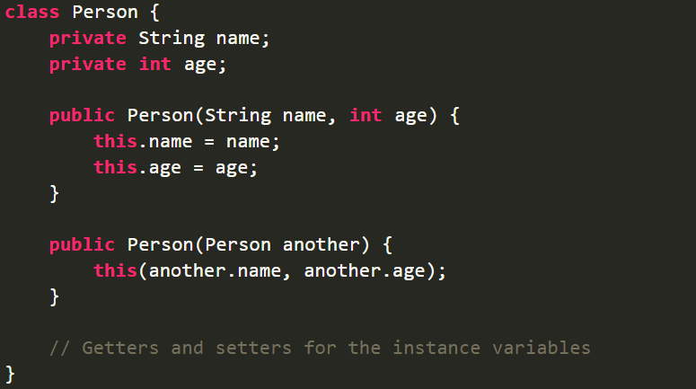
Default Constructor
If you don’t provide a constructor for your class, C# creates one by default that instantiates the object and sets member variables to the default values. Constructor without any parameters is called a default constructor. In other words, this type of constructor does not take parameters.
Copy Constructor
A constructor that creates an object by copying variables from another object or that copies the data of one object into another object is termed as the Copy Constructor. It is a parameterized constructor that contains a parameter of the same class type.

Slide 7
SEALED CLASSES
The “sealed” keyword in C# is used to limit a class's or a member's ability to inherit from another class. A class or member there of that has the designation “sealed” cannot be inherited by another class or overridden by a derived class.
SEALED METHODS
The method that is defined in a parent class, if that method cannot be overridden under a child class, we call it a sealed method. That means by default, every method is a sealed method because overriding is not possible unless the method is not declared as virtual in the parent class. If a method is declared as virtual in a class, any child class of it can have the right to override that method.

Slide 8
PARTIAL CLASS
Partial Class allows us to define a class on multiple files i.e. we can physically split the content of the class into different files but even physically they are divided but logically it is one single unit only. A class in which code can be written in two or more files is known as a partial class. To make any class partial we need to use the keyword partial.
PARTIAL METHODS
A partial class may contain a partial method. One part of the class contains the signature of the method. An implementation of the Partial Method can be defined in the same part or other parts of the Partial Class. If the implementation is not supplied, then the method and all calls to the partial method are removed by the compiler at the time of compilation.

Slide 9
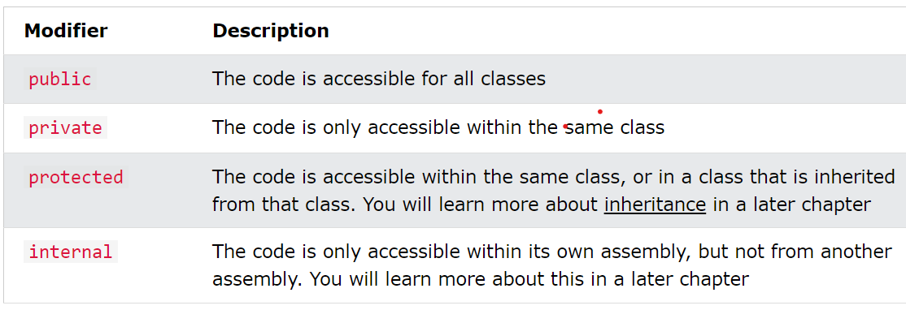
ACCESS MODIFIERS
Access modifiers (or access specifiers) are keywords in object-oriented languages that set the accessibility of classes, methods, and other members.

Slide 10
TUPLES
C# tuple is a data structure that provides an easy way to represent a single set of data.
If you need to return multiple values from a method in C#, there are three ways to do so without using tuples.
Using parameters
Using a class, struct, or a record type
Anonymous types returned through a dynamic return type
Tuples allow us to:
Create, access, and manipulate a data set
Return a data set from a method without using the parameter
Pass multiple values to a method through a single parameter

Slide 11
PROPERTIES
Before we start to explain properties, you should have a basic understanding of "Encapsulation".
The meaning of Encapsulation, is to make sure that "sensitive" data is hidden from users. To achieve this, you must:
declare fields/variables as private
Provide public get and set methods through properties, to access and update the value of a private fields.
Automatic (Short hand):
C# also provides a way to use short-hand / automatic properties, where you do not have to define the field for the property, and you only have to write get; and set; inside the property.

Slide 12
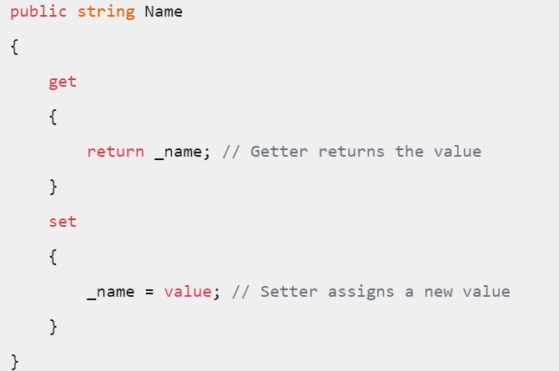
2. Classical Property:
They consists of pair of methods: a getter and setter. These methods are written separately in a method.
Get: write-only operation
Set: read-only operation
Whereas in Automatic it automatically generates get and set, we just have to write it inside the property. Here we have to write the logic by ourselves.

Slide 13
AGGREGATION, COMPOSITION AND ASSOCIATION
Aggregation:
If a class have an entity reference, it is known as Aggregation. Aggregation represents HAS-A relationship.
When use Aggregation?
Code reuse is also best achieved by aggregation when there is no is-a relationship.
Inheritance should be used only if the relationship is-a is maintained throughout the lifetime of the objects involved; otherwise, aggregation is the best choice.

Slide 14
ASSOCIATION
Association defines the connection between two classes that are set up through their objects.
A person can have only one passport. It defines the one-to-one
If we talk about the Association between a College and Student, a College can have many students. It defines the one-to-many
A state can have several cities, and those cities are related to that single state. It defines the many-to-one
A single student can associate with multiple teachers, and multiple students can also be associated with a single teacher. Both are created or deleted independently, so it defines the many-to-many

Slide 15
COMPOSITION
It represents a has-a relationship.
In composition, both entities are dependent on each other.
When there is a composition between two entities, the composed object cannot exist without the other entity. For example, A library can have no. of books on the same or different subjects. So, If the Library gets destroyed then All books within that particular library will be destroyed. This is because books can not exist without a library.

Slide 16
THANK YOU

